Slide 1
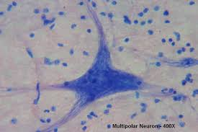
Nervous Neuron
L: Brain and spinal cord
F: Conducts electrical nerve impulses

Slide 2
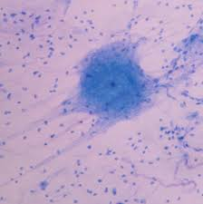
Nervous Cerebrum
L: Anterior portion of forebrain
F: Determines intelligence, memory, personality

Slide 3
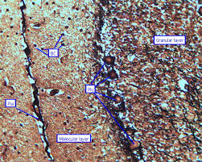
Nervous Cerebellum
L: Lower back portion of brain
F: Controls balance, coordination, body movements

Slide 4
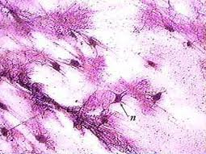
Nervous Spinal Cord
L: Spinal cavity
F: Sends messages between brain and body

